Slide 1
Lecture 3 Combinational units. Adders
Computing platforms, semester 2
Novosibirsk State University University of Hertfordshire
D. Irtegov, A.Shafarenko
2019

Slide 2
Some terminology
Combinational units: pure logical functions.
Output depends only on input
No side effect (except delay)
Can be described by single logical expression
Sequential units: have internal state
Output depends not only on the inputs
Input can have side-effect (changing internal state)
Require logical elements we did not study yet.

Slide 3
Popular combinatory units
Decoder
k inputs, 2^{k} outputs.
Interprets inputs as k-bit number n, sets n-th output to 1, all others to 0
Standard decoders usually have “Enable” input. When Enable is down, all outputs are down
Multiplexer
2^{k} m-bit inputs and one k-bit selector input
Connects n-th input to the output

Slide 4
2x4 decoder

Slide 5
Multiplexer (mux)

Slide 6
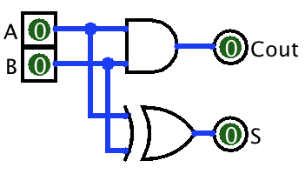
So, the adder
Two bit half adder
Adds two bits and produces result and carry bit
S=A$⊕$B, Cout=A^B

Slide 7
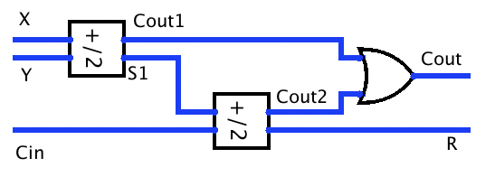
The full adder
Has three inputs: A, B, Cin
Also has two outputs: R and Cout
Can be constructed from two half adders

Slide 8
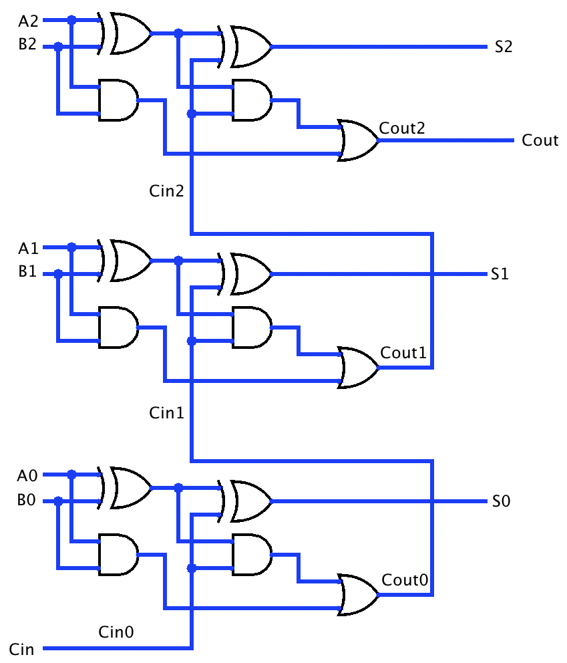
Three-bit adder
Place three full adders in a row
Connect Cout0 to Cin1, etc
Sounds simple and good enough for Logisim
For real devices, carry must propagate from bit 0 to N
This design is known as ripple carry adder
Delay ~= O(N)
We discuss this later

Slide 9
Logisim notation for repeating circuits

Slide 10
How to deal with carry propagation delay?
A sequential adder.
Carry propagation time for N-bit adder ~=N(delay of single adder)
Why bother building N adders if they cannot actually work in parallel?

Slide 11
Carry-save adder
Result is provided as two bits (carry not propagated)
10111010101011011111000000001101 + 11011110101011011011111011101111 = 21122120202022022122111011102212
To produce binary number, we still need to propagate carry
But we can add these saved-carry numbers without converting to binary
And propagate only on last stage
Carry-save adders are used in multiplicators, in cryptography, etc

Slide 12
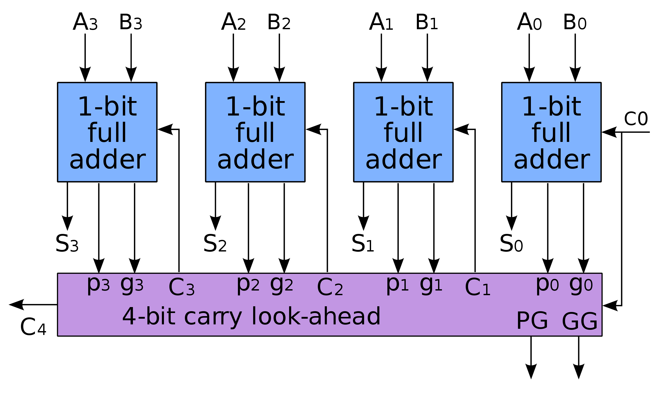
Carry-lookahead
Instead of Cout, every adder provides two signals, P (propagate) and G (generate)
P(A,B)=AvB
G(A,B)=A^B
C_{i+1}=G_{i}v(P_{i}^C_{i})
Actually, a recursive formula
C₄=G₃v(P₃^G₂)v(G₁^P₂^P₃)v (G₀^P₁^P₂^P₃)v(C₀^P₀^P₁^P₂^P₃)
Gate count O(N²), but delay close to constant

Slide 13
4-bit carry lookahead in Logisim
Delay depends on number of gates the signal passes between input and output
NOT on total number of gates
In this design, C3 produced from 7 input signals, but each of these signals pass only two gates
So, we can improve speed by increasing number of gates
In computing, simpler is not always better

Slide 14
Ways to produce multibit adder
Often, a combination of ripple carry and carry lookahead is used
16-bit adder can be implemented from 4-bit units as:
ripple-carry connected via carry-lookahead
carry lookaheads connected via ripple carry
carry lookaheads connected via second level carry lookahead
Other tricks, like carry-skip (aka carry bypass) adder
Read the Wikipedia…

